Slide 1
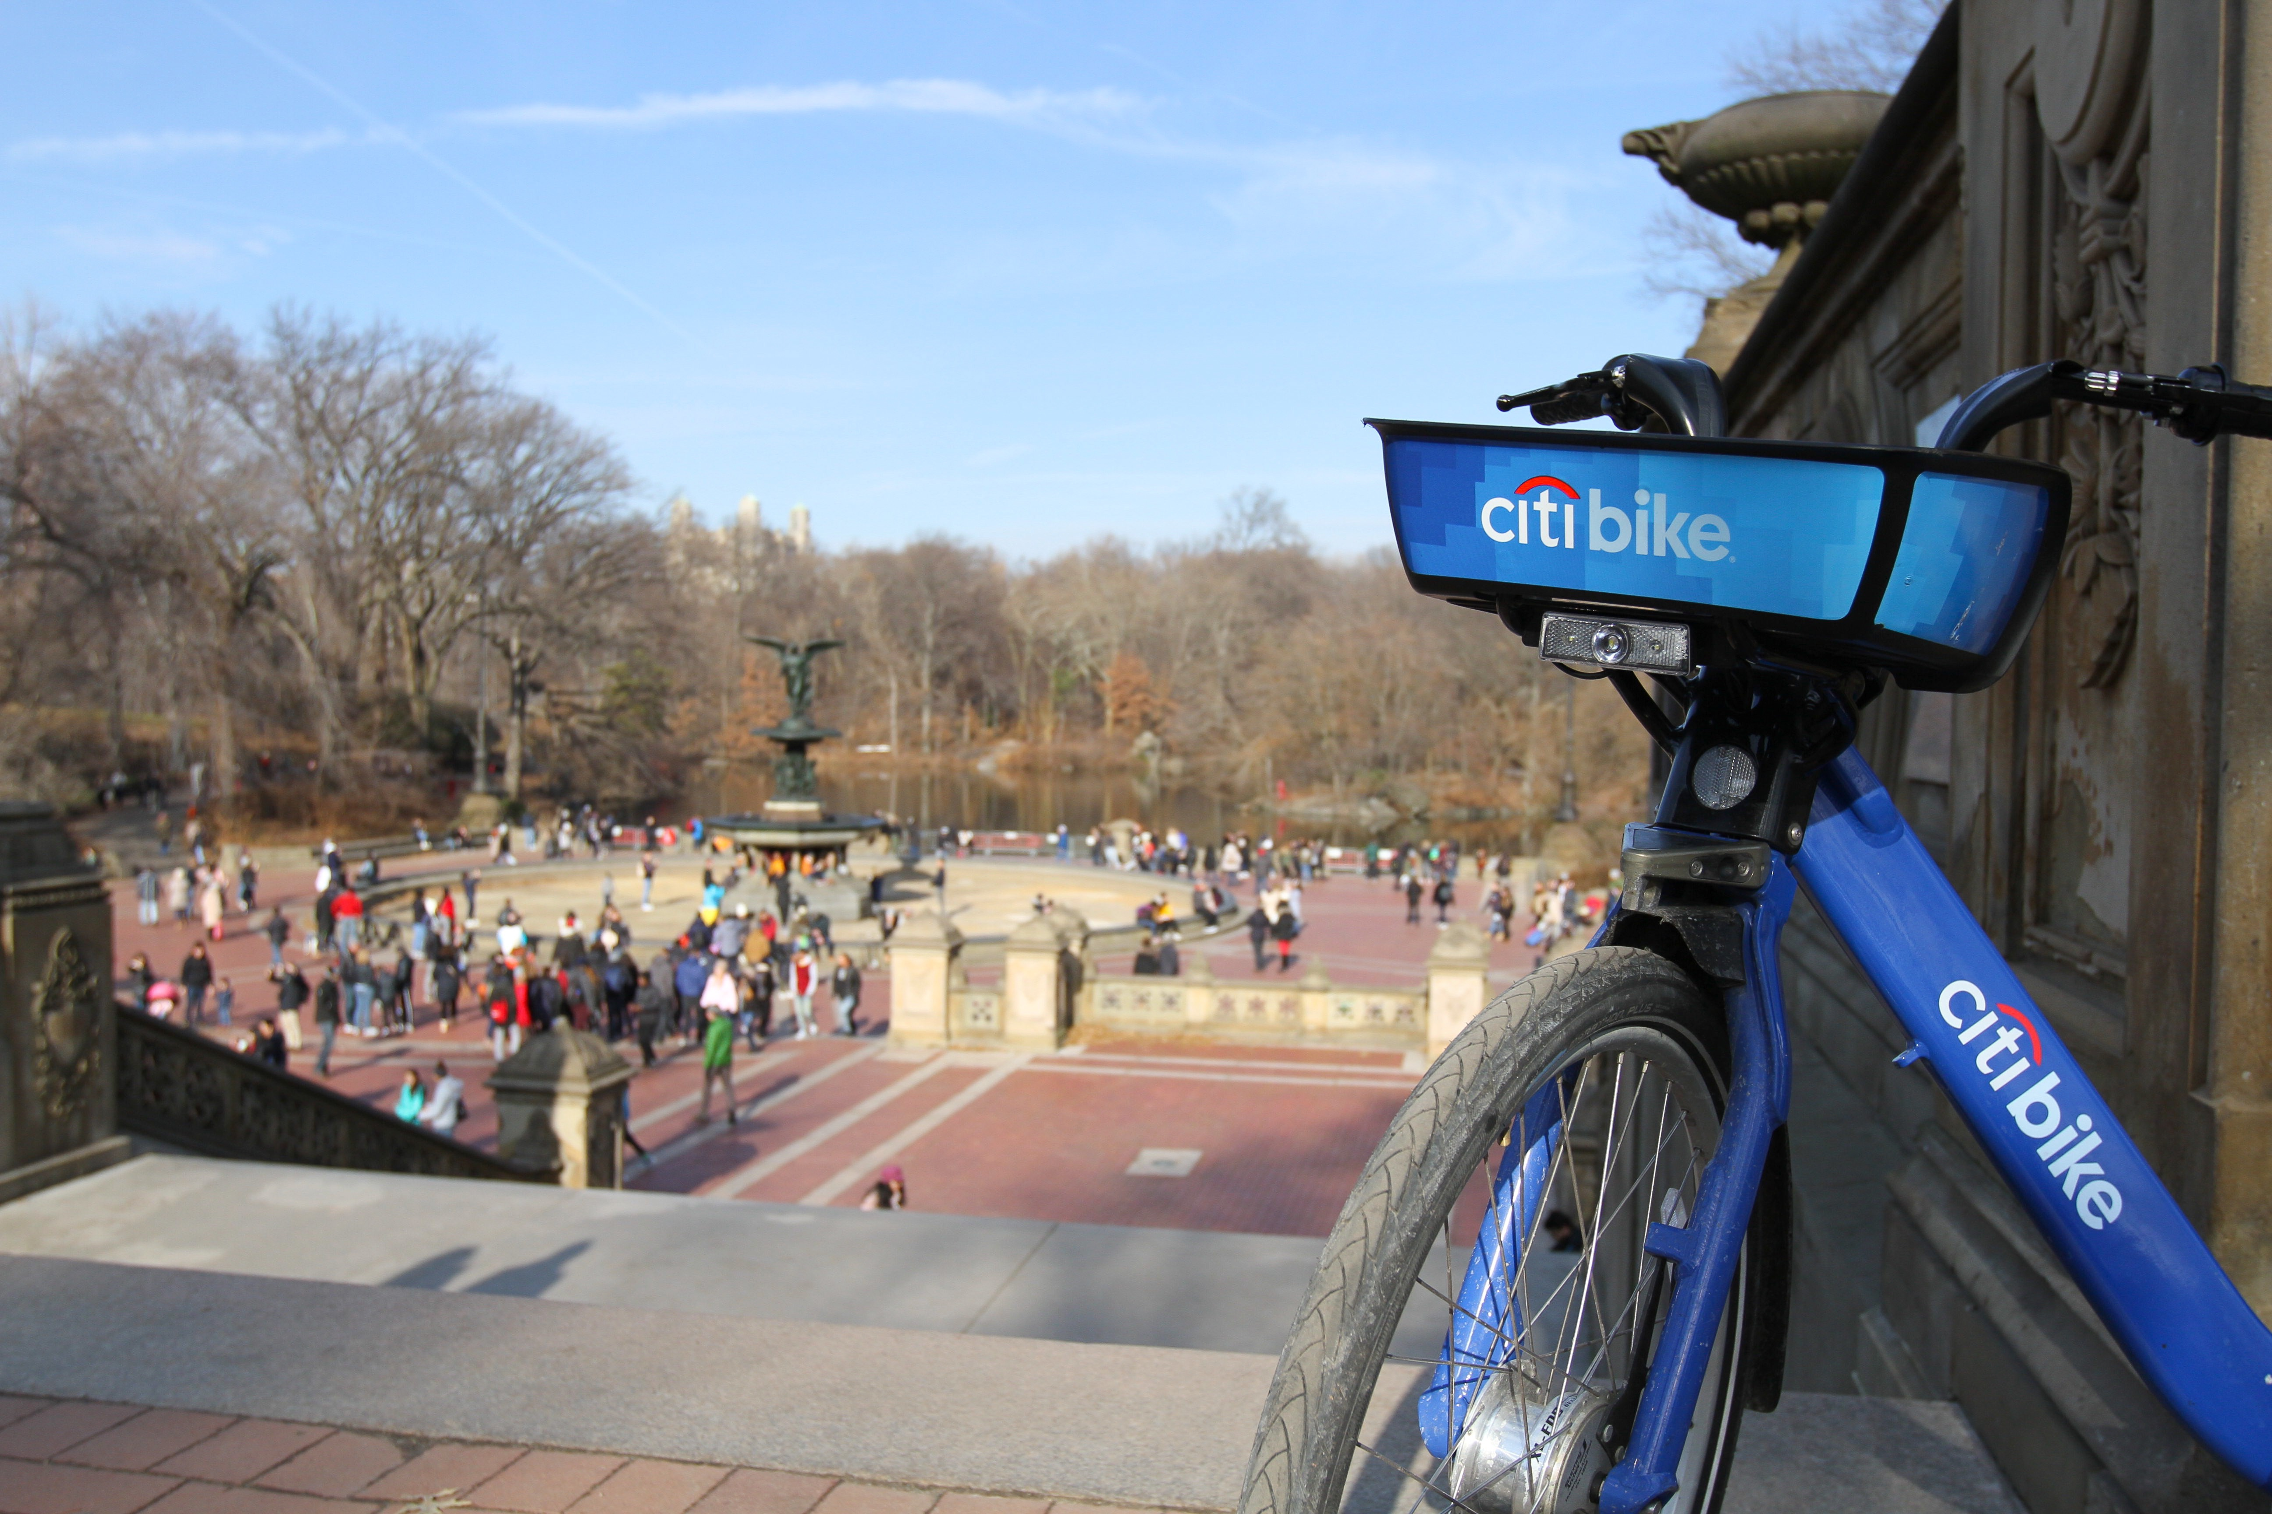
CITIBIKE ANALYTICS
2015 - 2019

Slide 2

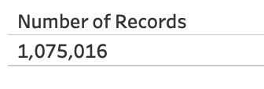
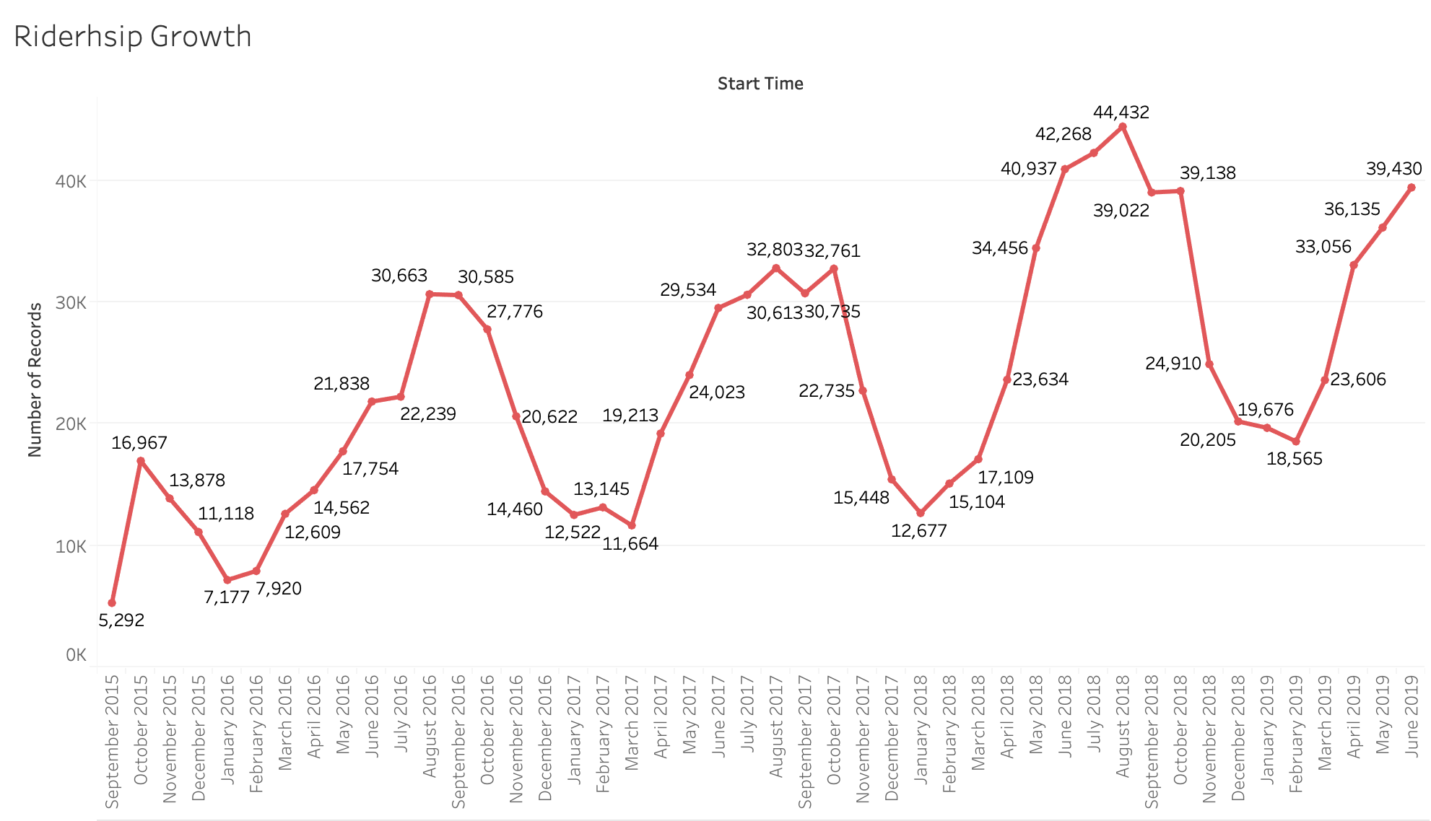
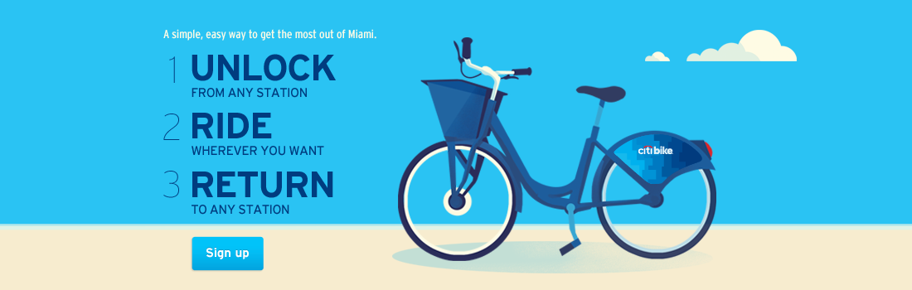
HOW IS IT BEEN GOING?
Max Rides:
2015 => 16,967
2016 => 30, 663
2017 => 32, 803
2018 => 44,432
2019 June so far:
39, 430
2015 – 2018
261.87 % Max Growth
TOTAL
1,075,016

Slide 3
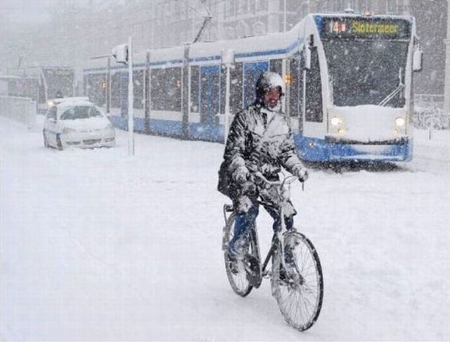
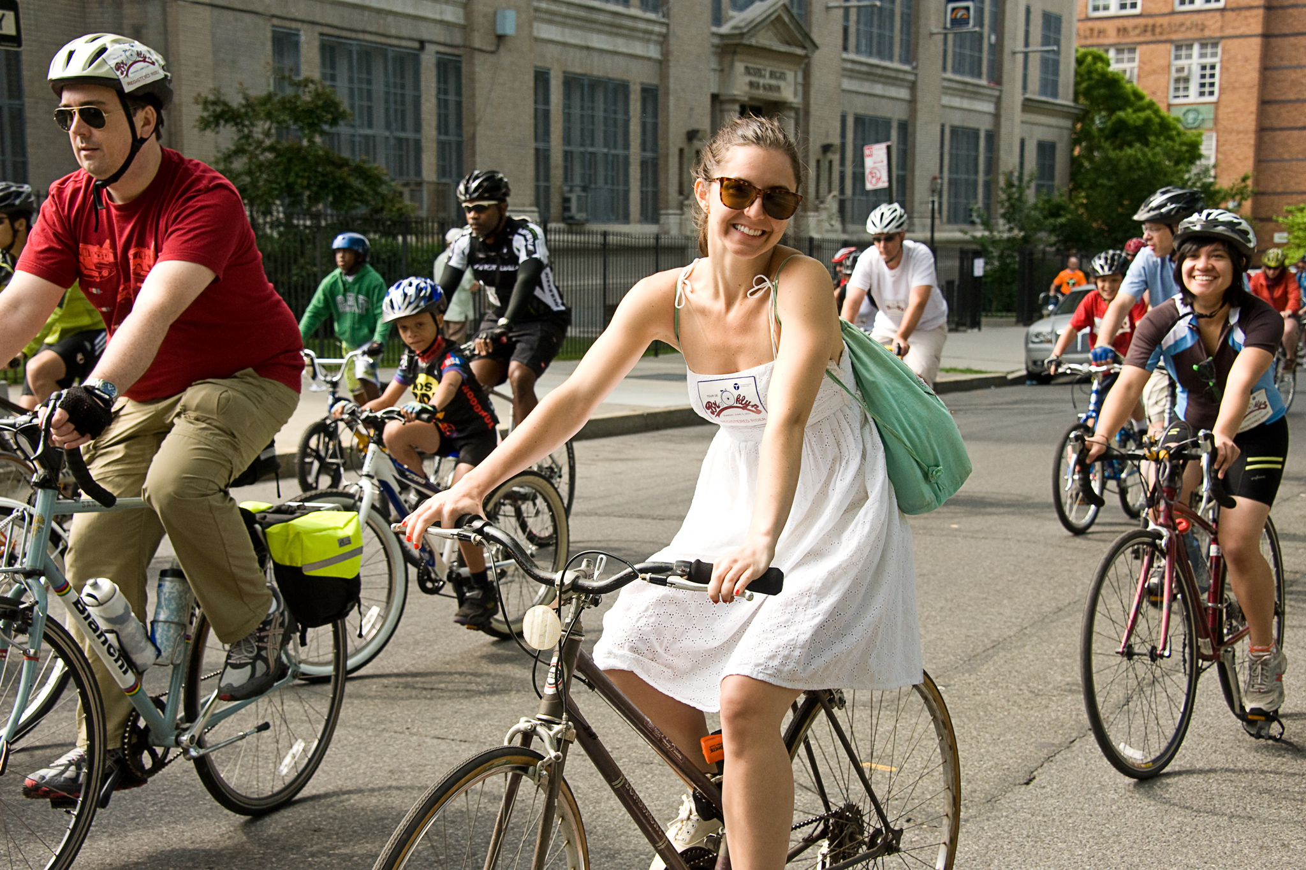
SUMMER OR WINTER?
What do people prefer?

Slide 4
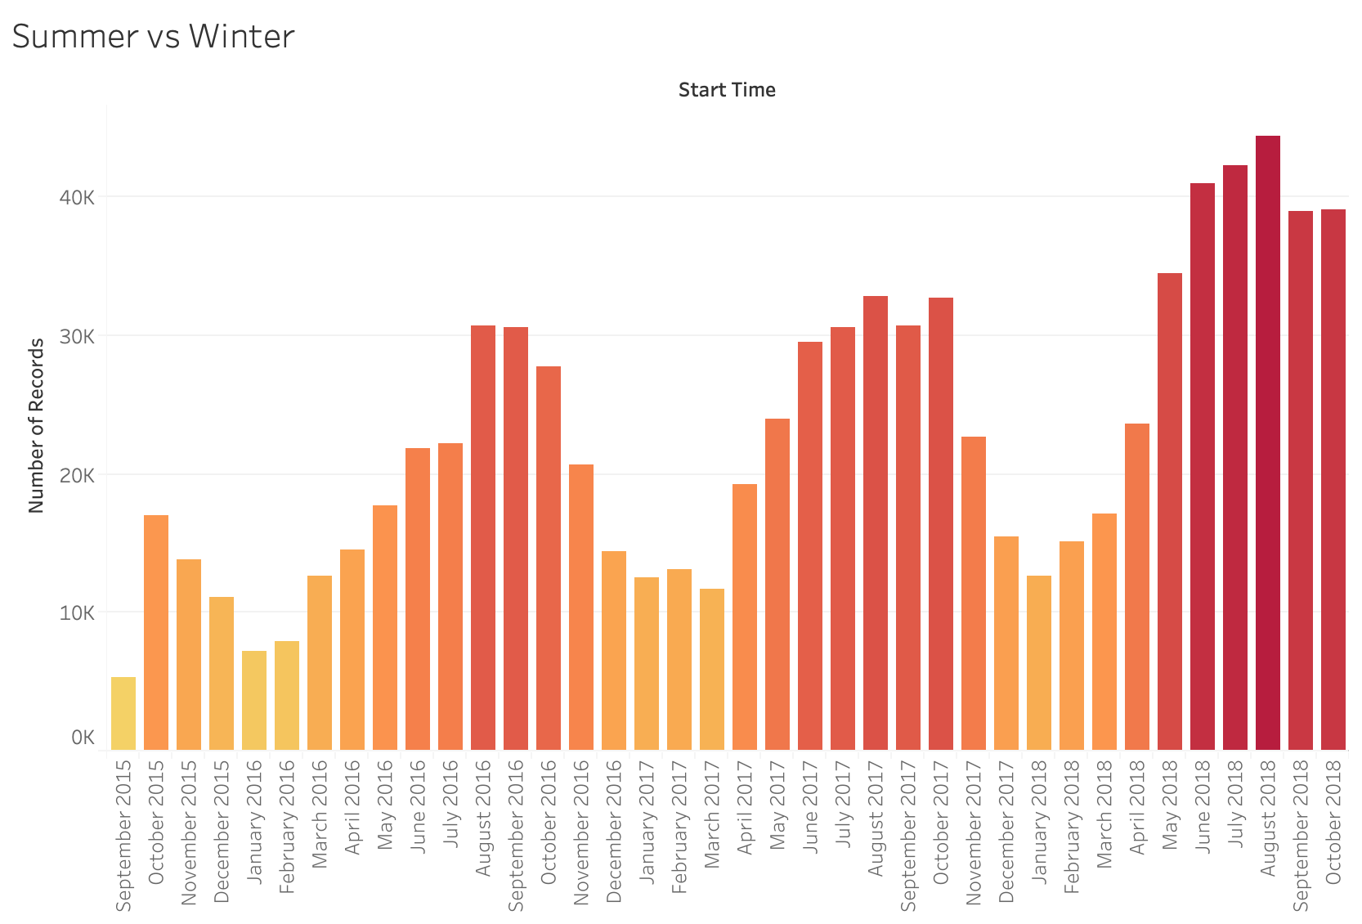
HEAT ON THE RIDE !!!
People love Summer
MORE RIDES
Darker colors.
From May to October

Slide 5
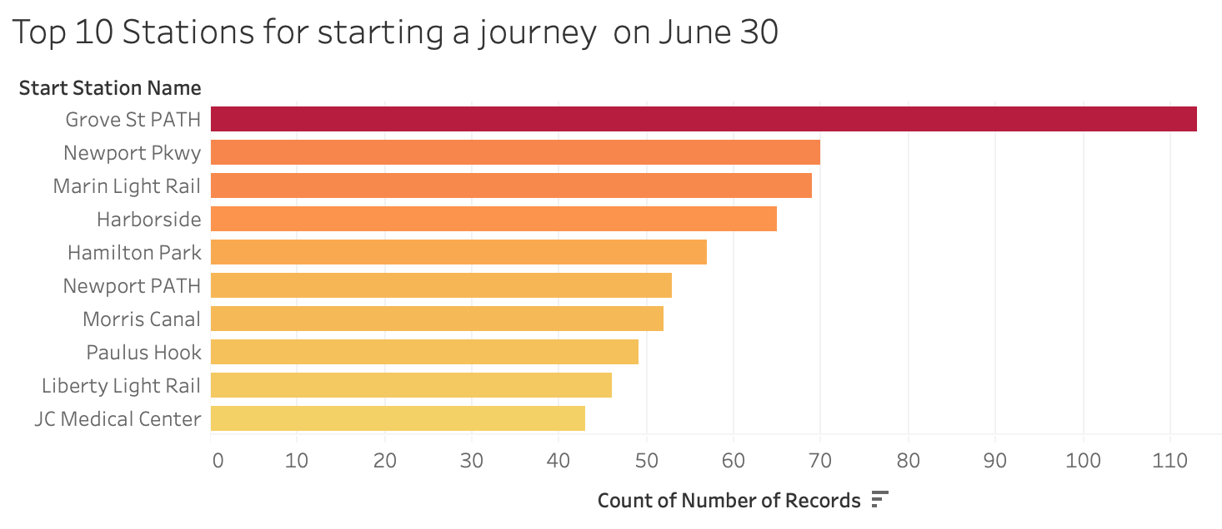
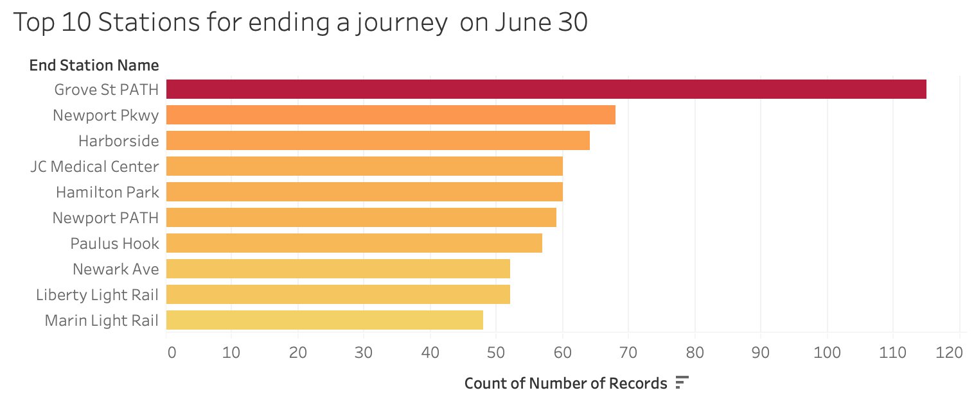
FAVORITE STATIONS JUNE: 30th
GROVE ST PATH !!!!

Slide 6
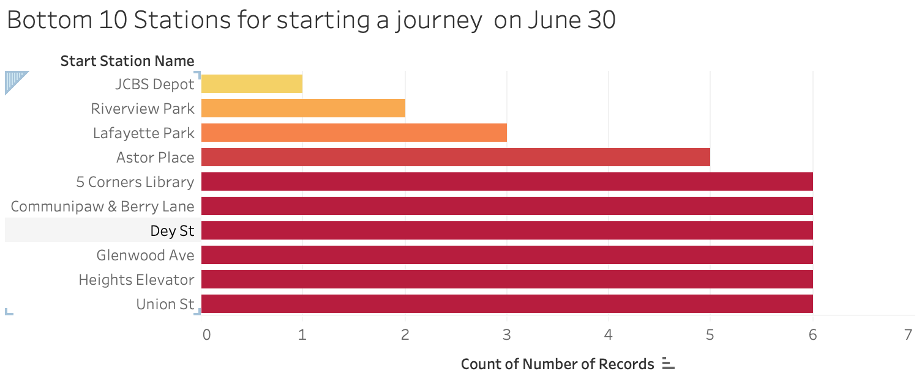
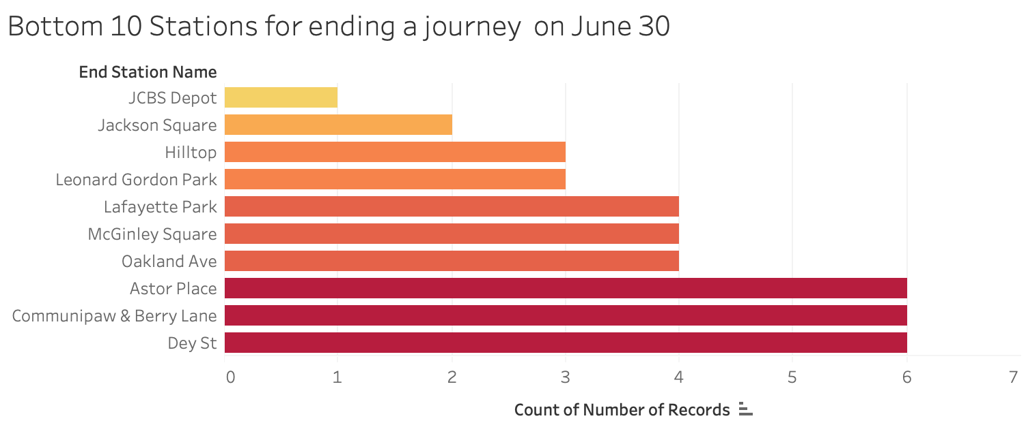
NOT SO FAVORITE STATIONS: JUNE 30th
JCBS DEPOT

Slide 7
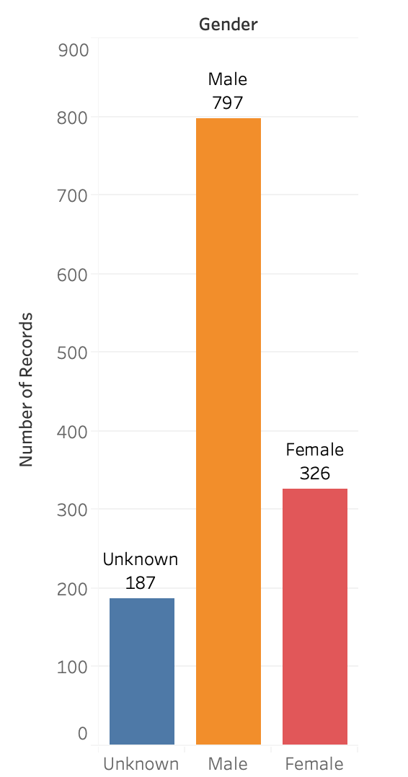
WHO RIDES : JUNE 30th

Slide 8
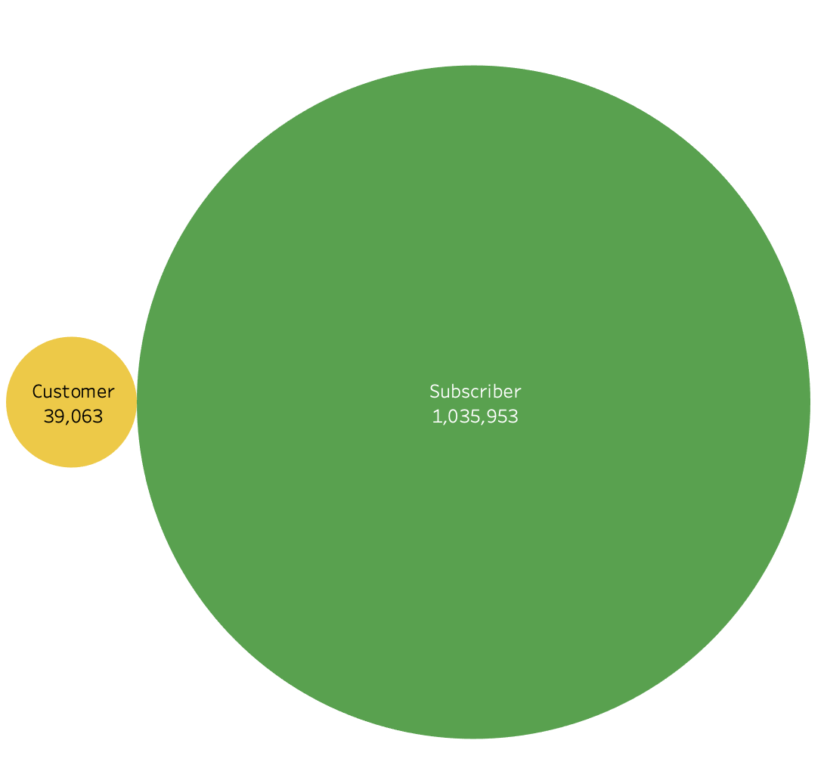
WHO RIDES MORE?
Subscriber or occasional rider?
Tourists?
City Resident?
On urgency?
Neighborhood Resident?
Car repairing?
Short daily ride?

Slide 9
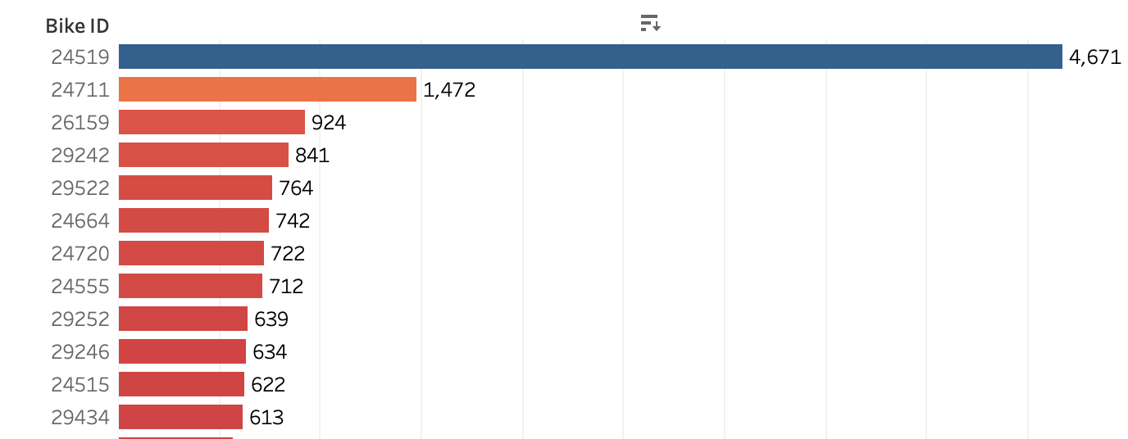
A LONG RIDE → MAINTENANCE
LUCKY NUMBER !!! 24519
REPAIR IT!!! IT IS WORTH IT
Most used Bikes need repairing sooner.

Slide 10
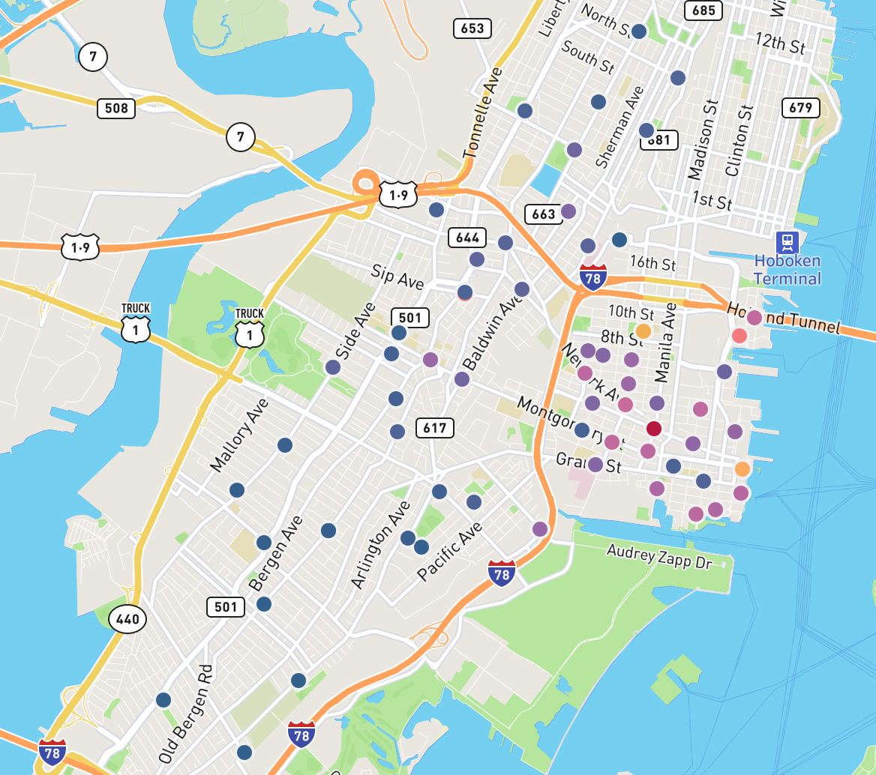
MOST USED STATIONS: WHERE ARE THEY?
STATION ID: 128, 964
NAME: GROVE ST PATH
STATIONS IN BLUE
LEAST USED

Slide 11
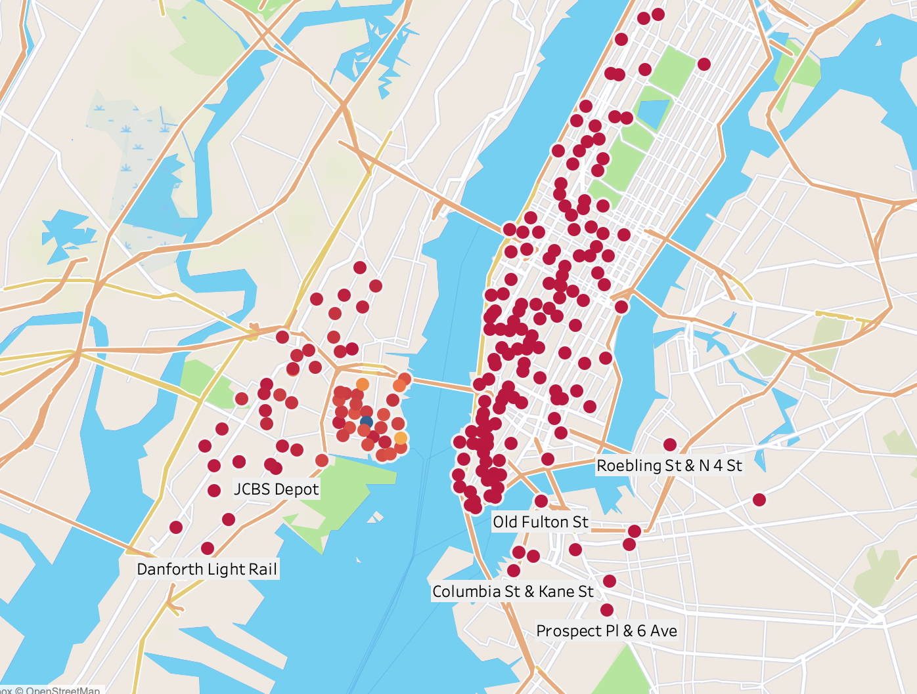
START AND END STATIONS?
And more places to go and end !!!
Places to Start
Places to End

